Slide 1
Welcoming Message
Prof. Michael Ng
Head of Department of Mathematics
Notes:
Prof. Ng

Slide 2
Staff Introduction
Prof. Michael Ng
Head of Department of Mathematics
Notes:
Prof. Ng

Slide 3
Programme Information
Dr. Leevan Ling
Associate Head of Department of Mathematics
Programme Director for BSc Joint Programmes
Notes:
Dr. Ling

Slide 4
BSc (Hons) in Mathematics and Statistics
Both mathematical and statistical concepts
Flexibility of majoring WITHOUT a concentration
Option of nil or up to 2 concentrations:
Operations Research
Scientific Computing
Quantitative Data Analysis
Actuarial Statistics* (with Simon Fraser Univ)
Financial Risk Management* (with School of Business)
Obtain a concentration with 7 electives
*subject to university final approval

Slide 5
BSc (Hons) in Mathematics and Statistics
Mathematical training
→ Strong numerical sense
→ Problems solving
→ Analysing skills
→ Logical thinking
Strong quantitative background (IS) highly desirable in today’s job market

Slide 6
General Education in Numeracy
GCNU Numeracy

Slide 7
The lecturer actually gave us daily example so as to motivate us the learn more.
The maths are not the usual maths that we met before, still it is interesting.
A lot of inspiring earthly matters are being discussed in class, made us know a lot about our surrounding.

Slide 8
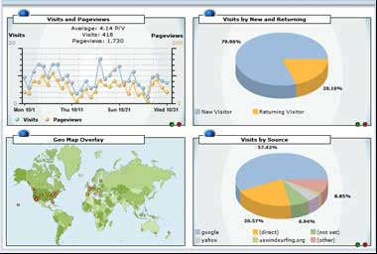
Non-major recreational math
Running out of credits for GCNU courses but interested in more real-life-related and easy-going math? We have the courses just for you!
MATH 1007 Delicate Mathematics
MATH 1015 Introductory Statistics with Software
MATH 1016 Mathematics Behind Movies and Music
MATH 1017 Mathematics for Personal Financial Management
All courses can be taken as free electives

Slide 9
Academic Advisors
Academic advisors can help you with:
Course selection
Matters concerning policies & academic regulations
Plans for exchange study
Plans for postgraduate study
Job search
Follow-up referrals
Stay in touch with your academic advisor!

Slide 10
Got a Question in Math?
Contact us ASAP when you have trouble with math!
Instructors
Teaching Assistants
NEC at OEM 605

Slide 11
Math Student Society & Exchange Programme
Dr. Felix Kwok
Department of Mathematics
Notes:
Prof. Ng

Slide 12
Math Society
Mission:
To serve students in the Dept. of Mathematics
To act as a bridge between students and the department
Role of Math Society Advisor:
Contact point between Math Society and Department
Advise on proposed activities
Recruitment of committee members: some time in October
For more information: come talk to me!

Slide 13
Exchange
Deadline: early December
Application through International Office
Our role: help you design your program abroad and make sure you can transfer credits back
http://www.math.hkbu.edu.hk/stuarea/index2.php

Slide 14
Display from Math Department Web page
Read carefully the application procedure as outlined in http://intl.hkbu.edu.hk/student_01_01_02_03.php
Transfer of Units for Major Core/ Major Elective Courses
Before submitting the completed application form
Download the detailed syllabus of the course(s) you plan to take abroad (e.g. Introductory Linear Algebra from Swansea University) and check that there are at least 39 contact hours for each course.
Find an equivalent course at HKBU for which you would like to have your credits transferred (e.g. MATH2207 Linear Algebra).
Consult the course instructor (e.g. instructor of MATH2207 Linear Algebra) with the detailed syllabus to determine whether the courses are equivalent based on his/her professional knowledge.
Find program advisor to comment on your study plan.
(Note: There is no guarantee of success because it also depends on the approval of AR)

Slide 15
Display from Math Department Web page
Transfer of Units for Major Core/ Major Elective Courses
After returning to HKBU
Complete the application form provided here
For further information about the host institutions, please consult the International Office.

Slide 16
Exchange
Briefing sessions (organized by international office)
Late September
Late October
If you are interested, come talk to me

Slide 17
Internship
Dr. Mark Lau
Department of Mathematics
Notes:
Mark

Slide 18
Internship
Job Practicum I, II, III (each 1 credit)
MATH 3495, 3496, 3497
Grade S for satisfactory and U for unsatisfactory
Years 2 or 3 students
Period:
June to August every year
1 unit: > 120 hours (~ 3 weeks)
2 units: > 240 hours (~ 6 weeks)
3 units: > 360 hours (~ 9 weeks)
Final duration should be based on department’s decision and mutual agreements.

Slide 19
Internship
Industrial partners:
Hong Kong, mainland China, or overseas.
Every year we receive requests from companies or organizations.
We also actively look for suitable companies.
You may also suggest:
Tell us about the company.
Tell us about the expected duty.
Formal documents have to be signed between the department and the company.
Anyway, talk to us if you have any suggestion.

Slide 20
Internship

Slide 21
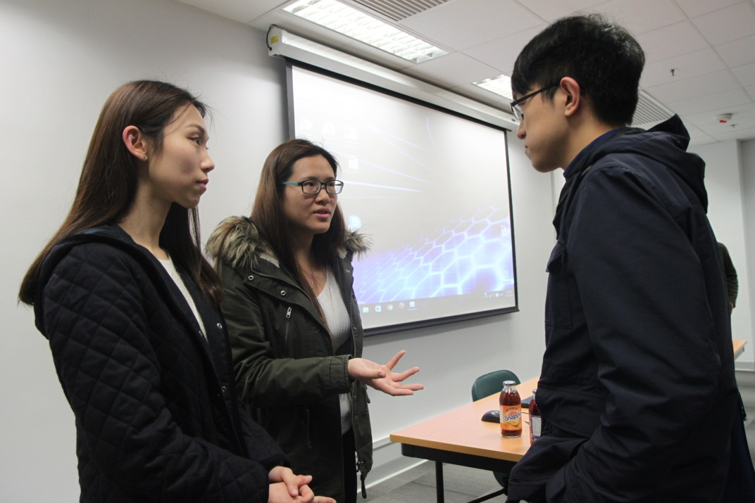
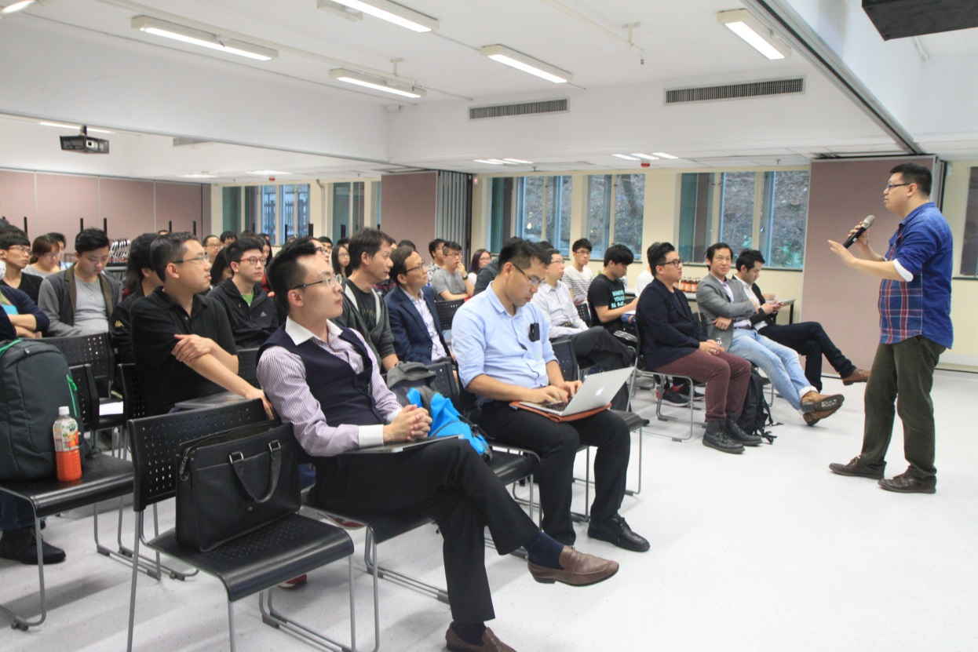
Fair Trade Foundation
& Convoy Financial Services
Several HK-based
technological companies

Slide 22
Internship
Insurance:
You are covered by the follow policies:
ZZG00003679ZC (worldwide)
TTT0001125ZC (worldwide except Hong Kong)
For details, see related documents at the Financial Office website.
Or, call Rebecca Choy of Financial Office at 3411-7683.

Slide 23
Internship
Allowance:
Some companies offer financial supports (e.g., travel expenses).
Some companies do not.
This summer, many students get $2,000 – $3,000 monthly allowance (meal + transportation)
The Minimum Wage Ordinance does not apply here.

Slide 24
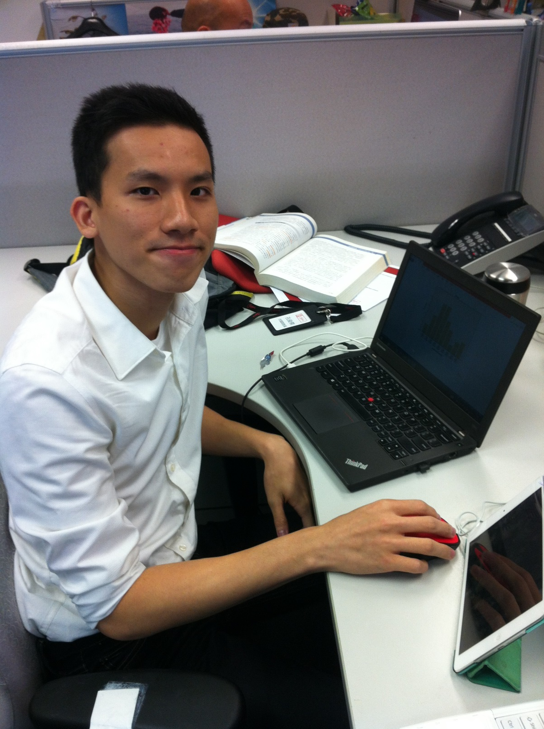
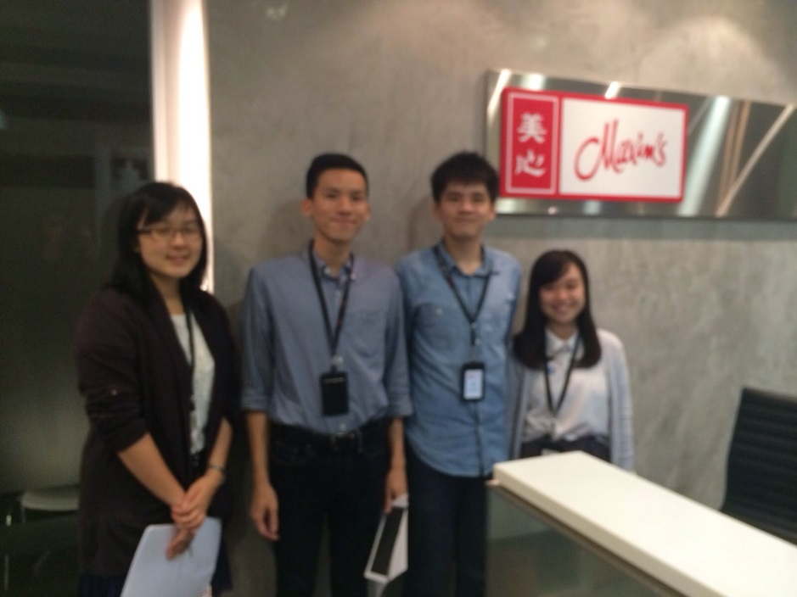
Roger working as an intern at Maxim’s:
Design questionnaires and interview guidelines
Collect and analyze data
Present it to boss

Slide 25
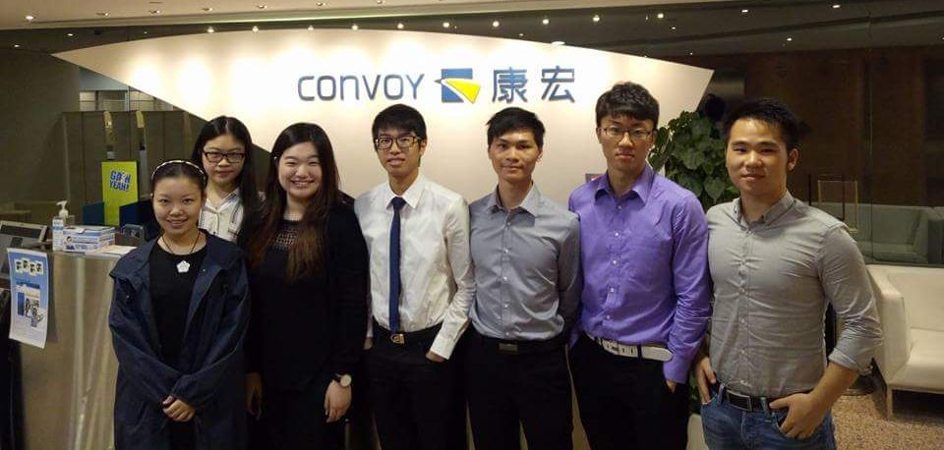
Wang Zexian working as a trainee at Convoy.

Slide 26
Yau Wing Tang working as an intern at Census and Statistics Department:
Analysis on Seasonal Adjustment on Unemployment Rate
Data analysis
Computer programming

Slide 27
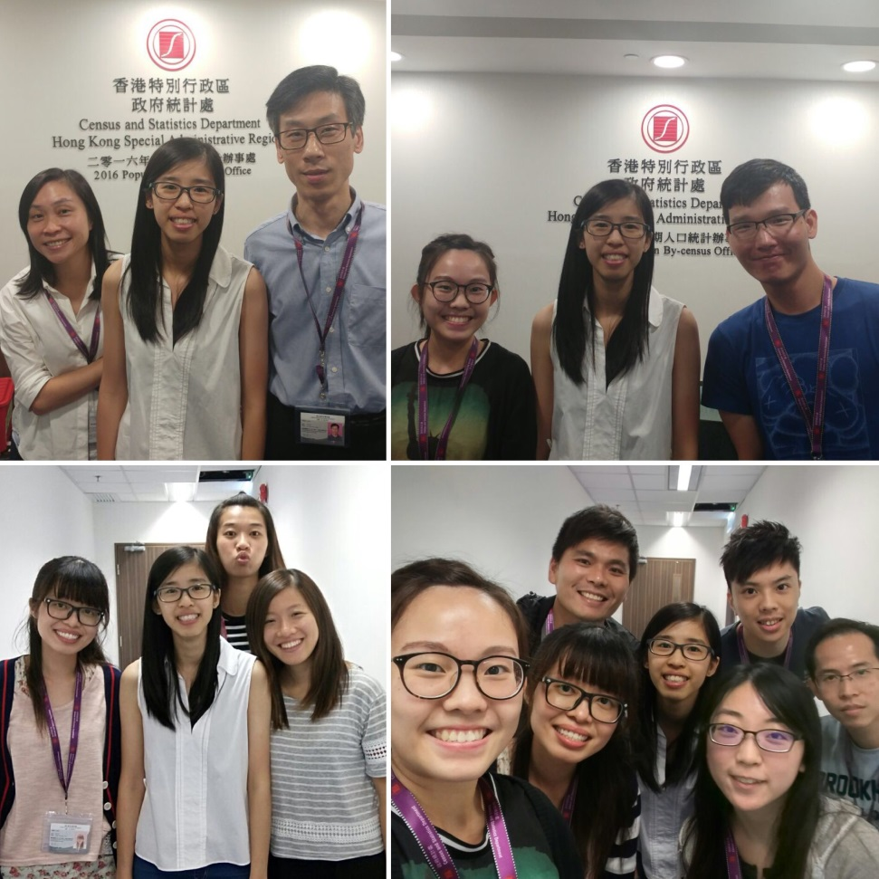
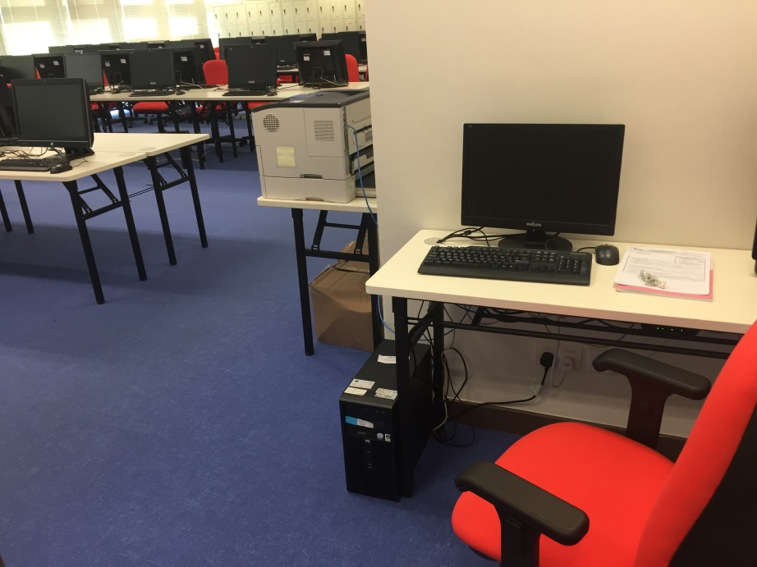
Wong Pui Man working as an intern at Census and Statistics Department:
Study the sampling methods adopted in the 2016 Population By-census (16BC).
Prepare training materials for Coding and Editing Staff of the 16BC.
Conduct evaluation on the training programme for the Coding and Editing Staff of the 16BC.

Slide 28
Song Zizhen working as an intern at Census & Statistics Department

Slide 29
Internship
Schedule:
March - April | Recruitment
Late April | Internal interview
May | Company selecting students
Early June – mid August | Internship period
Late Aug – Early Sept | Meeting selected students Oral report Photos

Slide 30
Internship
Talk to us if you have any questions:
Mark Lau
marklau@hkbu.edu.hk
3411 7023
FSC 1107

Slide 31
Inter-University Algo Trading Contest 2016
Dr. Andy Yip
Department of Mathematics
Notes:
Mark

Slide 33
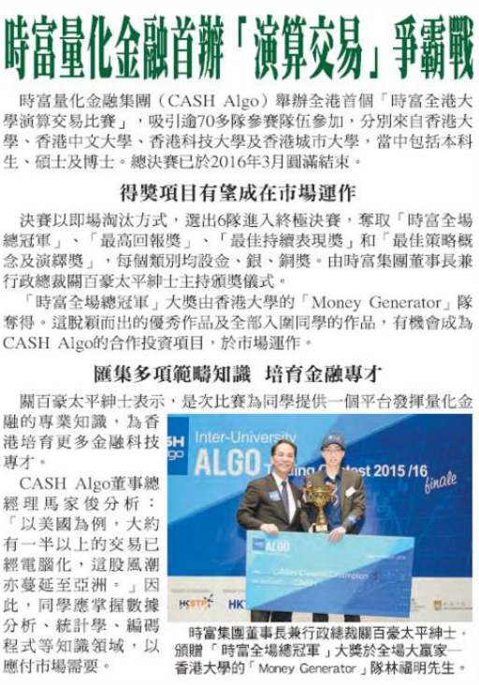
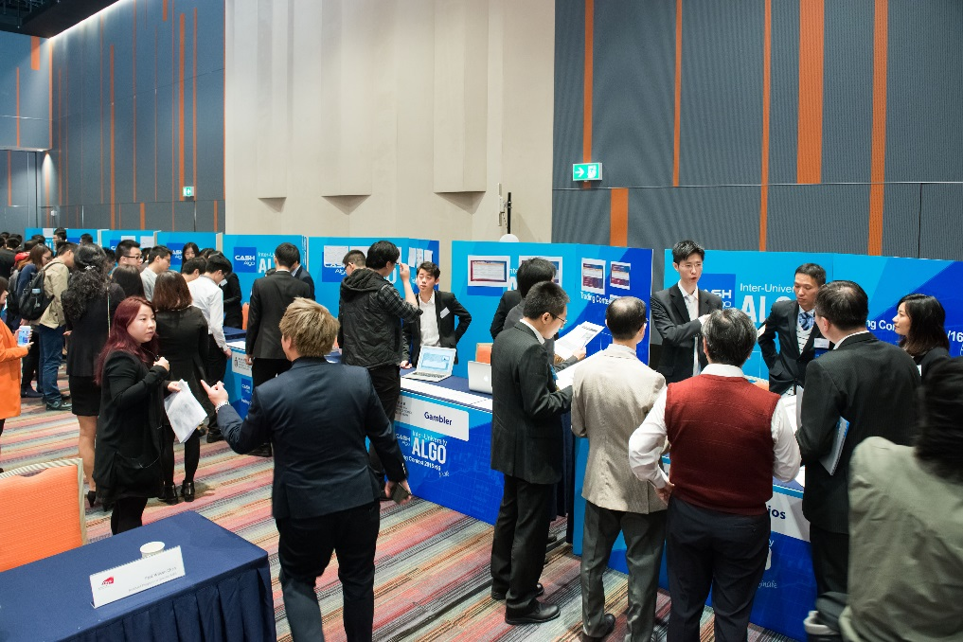

Slide 34
Inter-University Algo Trading Contest 2016
CASH Algo Finance Group (時富量化金融集團有限公司)
1-4 students in each group (mixed department okay)
Skills required:
Math, Stats, Quantitative Finance, Modeling, Programing (Python), Data Analytics, Reporting/Presentation etc.
Deadline to register: 17 October

Slide 35
Inter-University Algo Trading Contest 2016
First Round:
Submit a proposal to describe the trading idea
Submission deadline 21 Nov 2016
Compete within HKBU
By end of Nov: Announcement of First Round Winner
The winning team will represent HKBU in Final Round
Certificate for completing First Round
Final Round:
Code the idea
Submission deadline 16 Jan 2017

Slide 36
Inter-University Algo Trading Contest 2016
Event day:
19 Feb 2017 Sunday
Grand Hall at Hong Kong Science Park
Finalists will pitch their trading strategies for the Judging Panel to invest capital in.
The final evaluation will be balanced between capital raised and performance.

Slide 37
Inter-University Algo Trading Contest 2016
Information session:
Conducted staff from CASH
22 September, 15:00, RRS905
RSVP: Fill the sign-up sheet now, or email Ms. Vicky Hui (vickyhui@hkbu.edu.hk)
Registration of competition:
Send completed registration form to Ms. Vicky Hui (vickyhui@hkbu.edu.hk) or algocontest@cashalgo.com

Slide 38
Stay Connected:
Past & Coming Events
Notes:
Prof. Ng

Slide 39
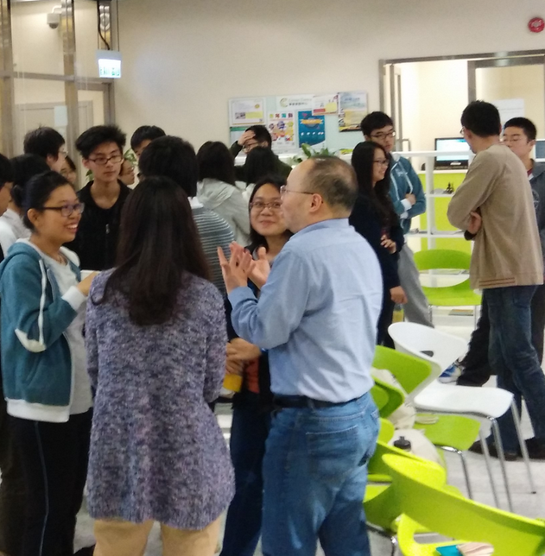
Café Mathematique
A series of informal events connecting you to:
Alumni
Professors
Other current students
Community
Snacks, beverages and plenty of interactions!

Slide 40
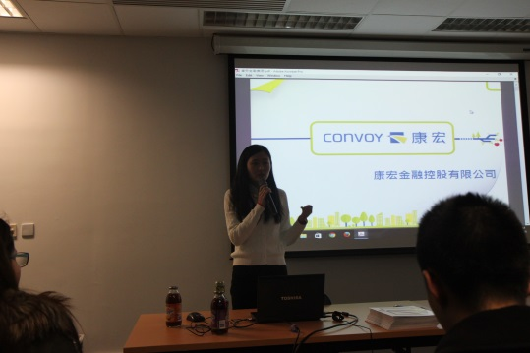
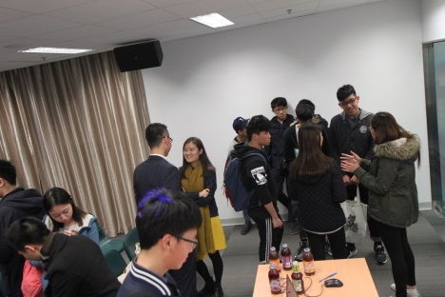
Café Mathematique
Past event (2016 March): An Introduction to Internship Opportunities
Sharing by The Fair Trade Hong Kong Foundation (Ms Gladys Yun, Project Officer) and The Convoy Financial Services Limited (Melanie Hu, Associate Director)

Slide 41
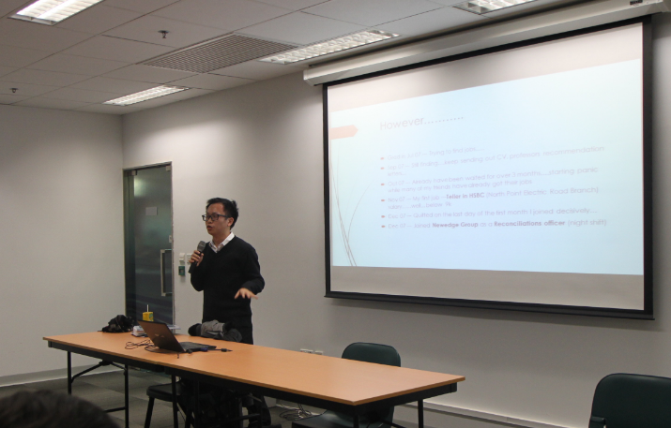
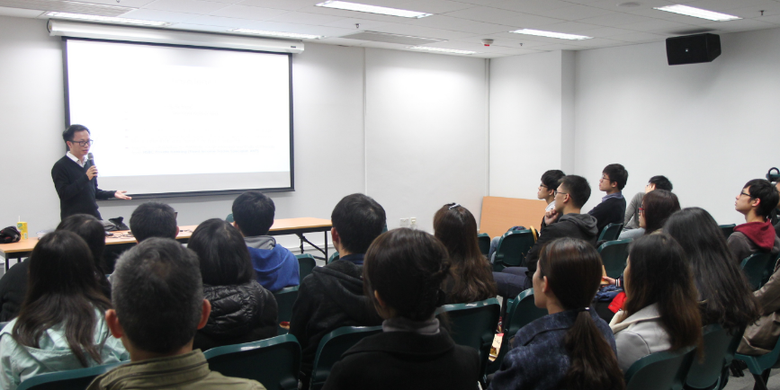
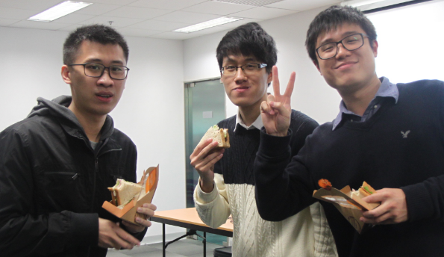
Café Mathematique
Past event (2016 January): An Introduction to Trading and Banking for Job Seekers
Sharing by Cyrus Yeung, Trader of HSBC

Slide 42
Café Mathematique
Coming events in 2016-17 include:
Job sharing by alumni
Career talk
Further study sharing
Curious about your future career? Fancy going abroad for further study? Interested in connecting with alumni? Stay tuned! Stay connected!

Slide 43
Free chat time for advisors and advisees Light Lunch
Notes:
Kong Ka Chun

