Slide 1
MATH2206
Probability and Statistics

Slide 2
Course Instructor:
Dr. PENG Heng
Course homepage:
www.math.hkbu.edu.hk/~hpeng/Math2206.html
Assessment:
Assignments/Example classes/Test 30%
One assignment every two or three weeks
One 50-min example class every week
One mid-term test
2-hour Examination 70%

Slide 3
Textbook:
Mann, P. S. (2013) Introductory Statistics (8th ed.)
can be bought in the campus bookshop
Tool:
a scientific calculator approved by HKEA
Software:
neither in the mid-term test nor the final exam.
GCNU1006 Discovering HK by Statistical Software
MATH1015 Introductory Statistics with Software — strongly recommended

Slide 4
STATISTICS
INTRODUCTION

Slide 5
What is Statistics?
A science of data
Data
collection
analysis
interpretation
Presentation
Making decision based on such analyses

Slide 6
Career Prospect
Statisticians
Government (Census & Statistics Department)
Market research (AC Nielsen; MillwardBrown)
Finance (JP Morgan; HSBC; Standard Chartered; Bank of China; Bank of East Asia)
Research (universities; ArborMetrix)
Actuaries
Professional examinations
Further Studies
Harvard; Columbia; Brown; Johns Hopkins; Purdue
Imperial; École Polytechnique; Humboldt-Universität zu Berlin
Australian National University

Slide 7
Why Statistics?
The amount of data available has increased almost beyond comprehension (Big Data).
As a result,
statistics is used for research in almost all professions, from medicine to sports;
almost all newspapers and magazines these days contain graphs and stories on statistical studies.
Laymen and professionals need statistics.

Slide 8
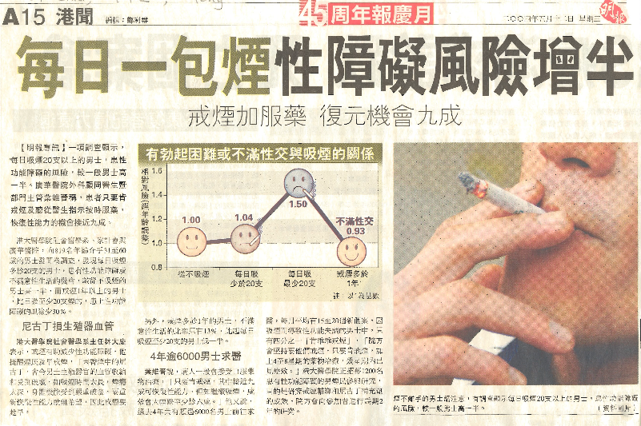
Johns Hopkins;

Slide 10
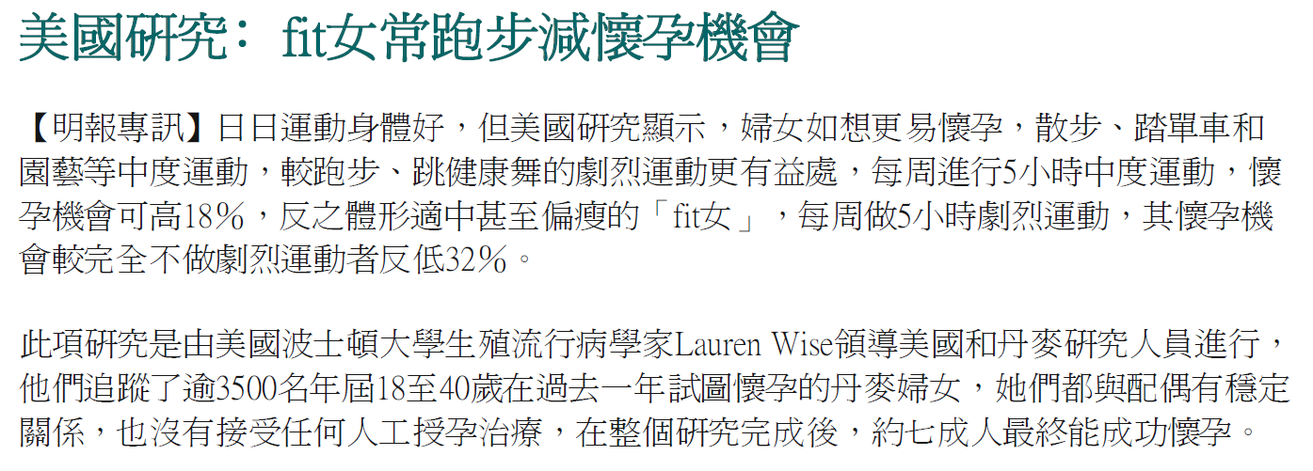

Slide 11
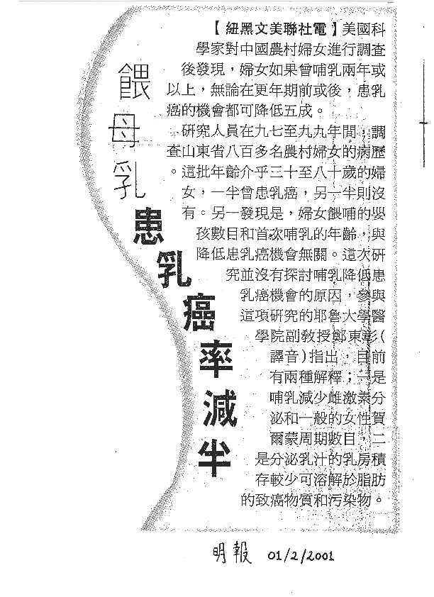

Slide 12
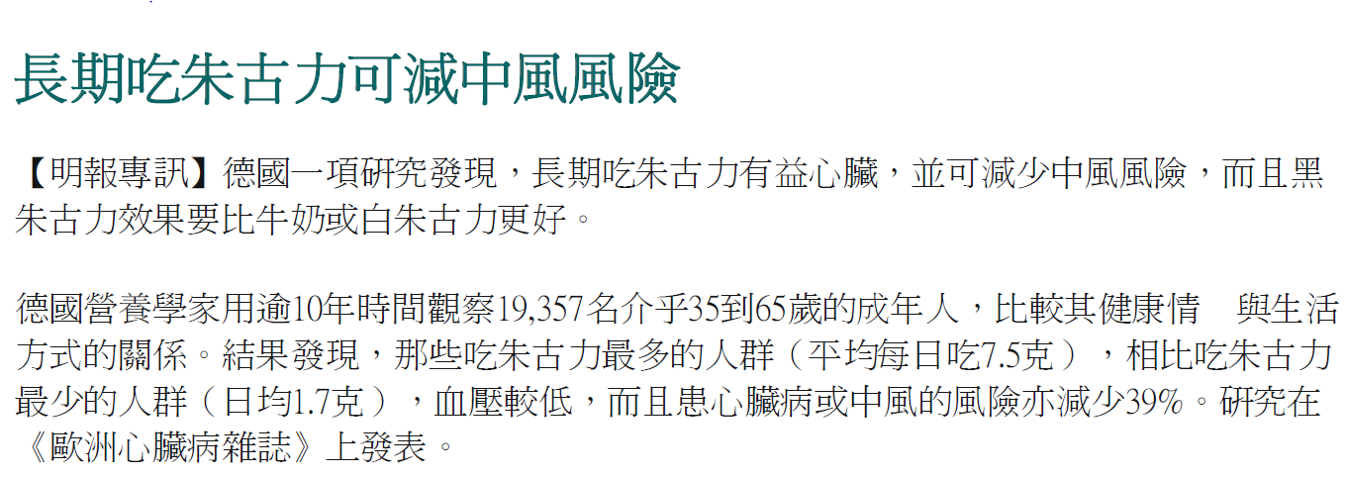

Slide 13
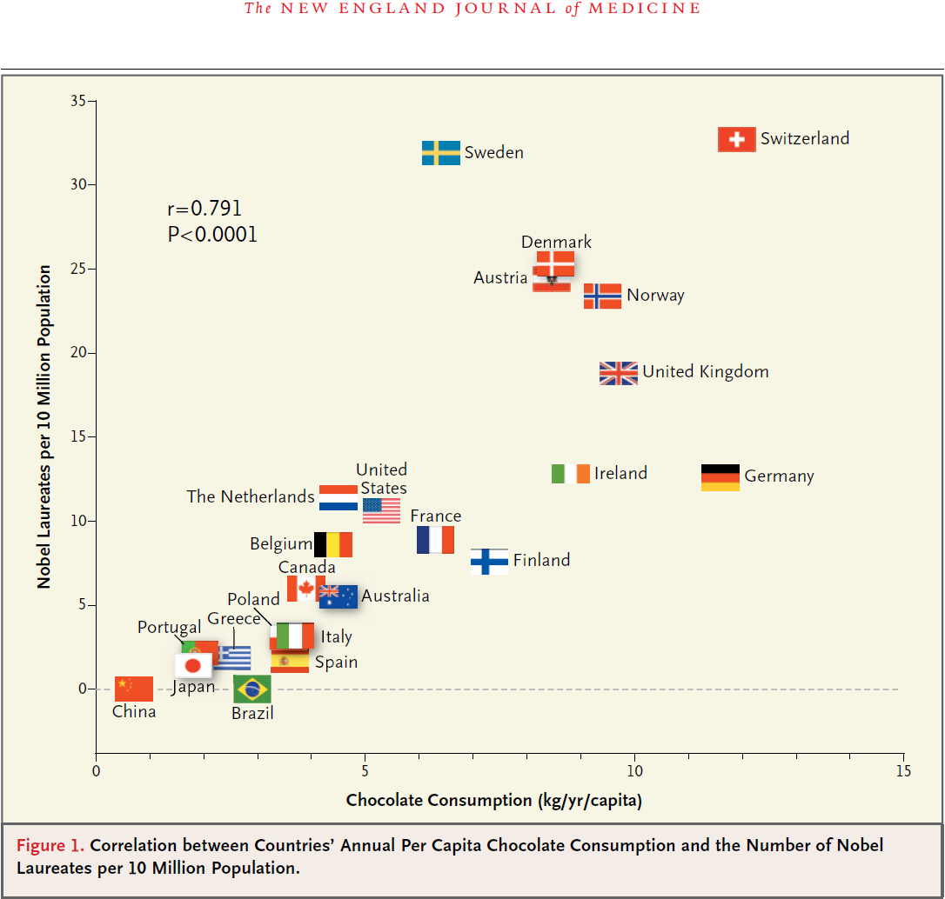

Slide 14
Origin of Statistics
Census: count persons and property and the problem of describing, summarizing and analyzing census data.
Descriptive statistics
Casino: games of chance.
Probability theory

Slide 15
Statistical Inference
Statistical information usually arises from a sample of a population (from observations made on only part of a large set of items), and this means that its analysis requires generalizations which go beyond the data.
The mathematical theory which enables us to make inference is Probability Theory

Slide 16
Statistics Methods
The methods can be applied regardless of whether the data are IQs, EQs, incomes, GPAs, test scores, computational times, tax payments, heights, weights, temperatures, number of births, and so on.

Slide 17
Examples
Social science: Among 200 retired persons, 132 stated that they prefer living in an apartment to living in a one-family home. Does this refute the claim the 70% of all retired persons prefer an apartment to a one-family home?
Natural Science: Among 200 citrus trees exposed to frost, 132 showed some damaged to their fruit. Does this refute the claim that 70% of all citrus trees exposed to frost will show some damage to their fruit?
Industry: Among 200 transistors made by Chiu’s Company, 132 passed an accelerated performance test. Does this refute the claim that 70% of all Chiu’s transistors will pass the test?
All these questions can be solved by exactly the same statistical method.

Slide 18
Variables and Measurements
Statistical data are the raw material of statistical investigations.
Statistical data arise whenever measurements are made or observations are recorded.

Slide 19
Variables and Measurements
Variable types:
nominal data
ordinal data
interval data
ratio data

Slide 20
Variables and Measurements
Nominal data
Categorical
yes/no
beer/juice/milk/coke/water
Ordinal data
Categorical
set up inequalities
good/fair/serious/critical
high school/bachelor’s/master’s/doctorate

Slide 21
Variables and Measurements
Interval data
not categorical
addition/subtraction OK
multiplication/division NO
temperature
33C - 30C =13C - 10C = 3C
but we don’t say 30C is twice as hot as 15C
30C = (30)9/5 +32 F = 86F
15C = (15)9/5 +32 F = 53F

Slide 22
Variables and Measurements
Ratio data
not categorical
addition/subtraction OK
multiplication/division OK
all usual measurements of length, height, money, weight, volume, area, etc.

Slide 23
Variables and Measurements
which kind of data will be discussed in this course?
Ratio data, having the most complicated structure
Why?
The most complicated structure allows us to do whatever calculation we want to do!

